Slide 1

VeriSafe: Al-powered Fraud Detection System.
Building a platform that analyzes financial transactions in real-time to detect potential fraud. The frontend could be a dashboard for users to monitor their accounts and view flagged transactions, while the backend handles data processing and ML-based fraud detection.

Slide 2























Technical Approach
USER
INTERFACE
(FRONTEND)
CYBERSECURITY AND MONITORING
BACKEND
&
DATABASE SETUP
MACHINE LEARNING
& DEPLOYMENT

Slide 3
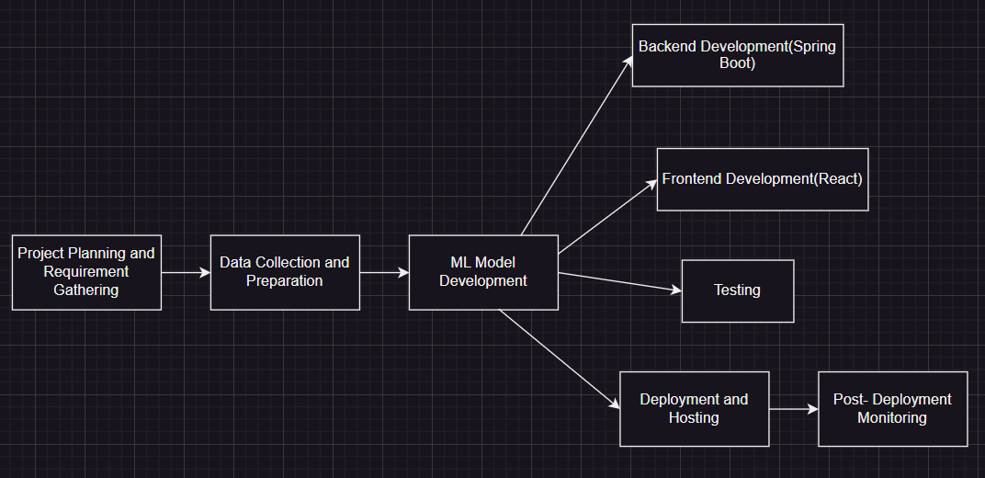
Diagramatic Representation

Slide 4
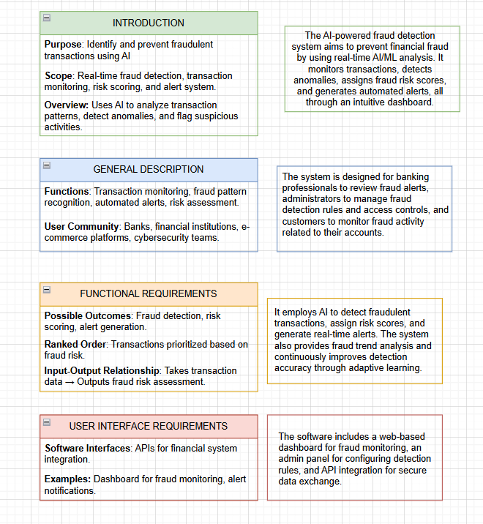
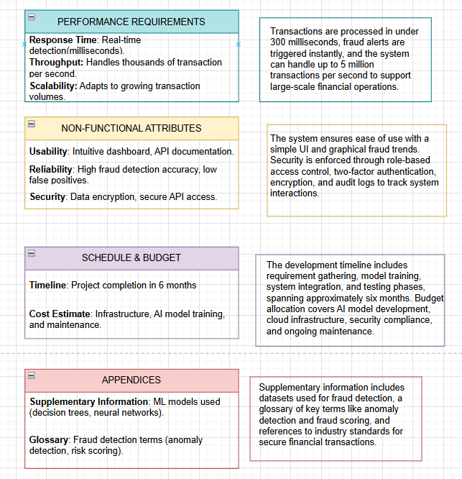
SRS DIAGRAM

Slide 5
Evaluation and Result
Accuracy: ~99%
Precision: ~0.80
Recall: ~0.72
F1-Score: ~0.76
Time-based analysis: higher frauds in early morning.
False negatives mostly involved small transaction amounts.

Slide 6
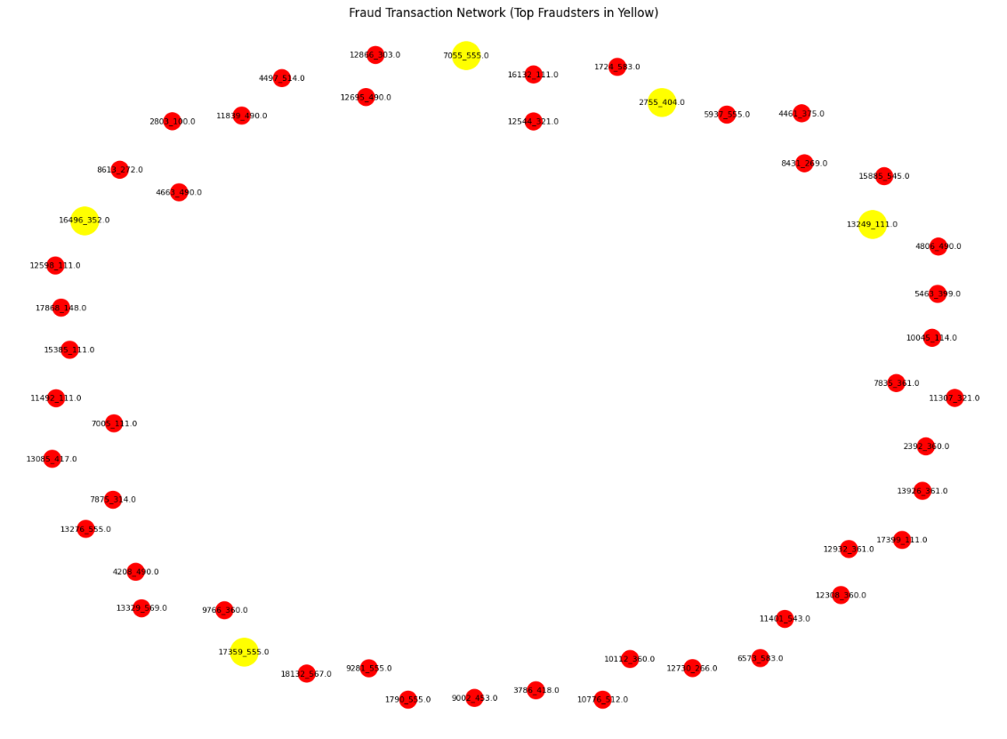
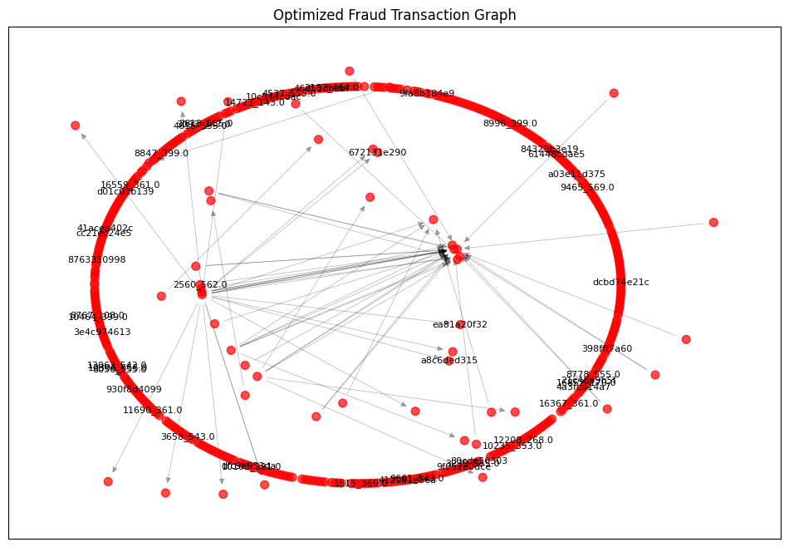
Results

Slide 7
Sustainable Development Goals
Decent Work and Economic Growth: By preventing fraud, our system helps ensure economic stability and protect businesses and consumers, promoting sustainable economic growth.
Reduced Inequality: By protecting consumers from fraud our platform can help reduce financial disparities and promote equitable access to economic opportunities.
Industry, Innovation, and Infrastructure: By implementing cutting-edge machine learning and AI techniques, our project contributes to technological advancement and innovation in the financial sector.
Responsible Consumption and Production: Your project can educate users about secure financial practices and promote transparency, responsible use of resources related to financial transactions.

Slide 8
Our Team
TEAM LEADER
Amishi Sharma
Branch – CSE(AI)
Member 1
Amishi Gupta
Roll No – 2200291520030
Member 2
Cherry Garg
Roll No – 2200291520064
Roll No - 2200291520031
Branch – CSE(AI)
Branch – CSE(AI)
THANKYOU~

